Slide 1
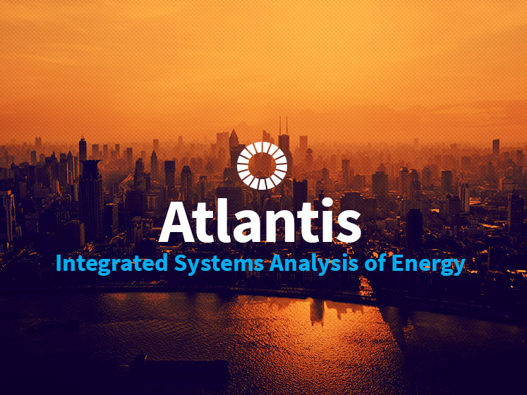
OSeMOSYS

Slide 2
Outline
Energy and electricity systems modelling
Electricity systems modelling
Introduction to electricity modelling in OSeMOSYS

Slide 3
2. Electricity systems modelling Objective: Understand the main building blocks of electricity systems models

Slide 4
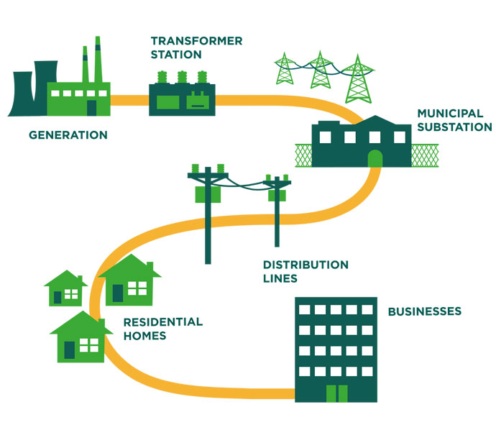
From energy to electricity system analysis
The electricity system is a heavily intertwined subpart of the comprehensive energy system.
We focus this training on modelling the electricity system.
More specifically, we look at finding the least-cost path for sustainable electricity system development.
Notes:
Cost is focal because countries have budget constraints. A number of other constraints derive from the availability of land, water, primary resources, climate change and the commitments of countries to achieving the SDGs. These all need to be factored in.

Slide 5

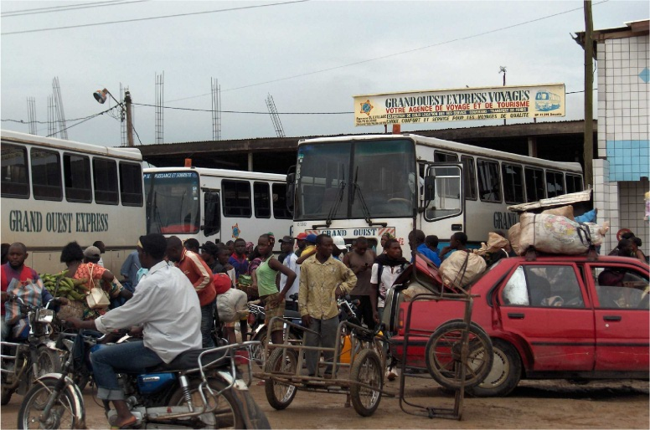

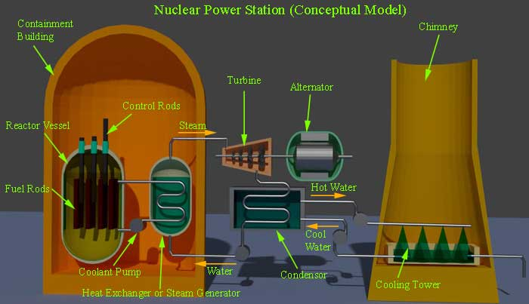
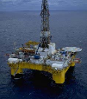
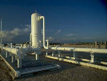
Electricity system
This is a complex system involving extraction and/or import facilities, power plants, transmission and distribution lines, storage, transport, industrial uses, residential uses, transportation and others.
Notes:
The energy system is a complex chain of components and flows connecting primary resources to final uses. In this case, the final service is electricity (e.g., for residential, industrial, commercial and transport use).

Slide 6
Elements of an electricity system model
The complexity of electricity systems requires a well-organized model structure.
Extraction or import
Conversion
Transmission and distribution
Conversion
PRIMARY
Oil
Gas
Coal
Uranium
Hydro
Wind
Solar
SECONDARY
- Diesel
Kerosene
Gas
Electricity
Coal
FINAL
Diesel
Kerosene
Gas
Electricity
Coal
USEFUL
Heating
Lighting
EVs
Ind. uses
Cooling
Etc.
Notes:
We have to take into account different technological options and a whole production chain for meeting the demand for electricity.
Electricity system planning considers the energy flow from the very beginning of the primary level or energy. Which resources are available nationally, and which are imported?
At the secondary level, the conversion process will change energy from one form to another, such as diesel and other oil products, or electricity.
Generated electricity needs to be transferred through transmission and distribution lines to reach end users and meet electricity demands (e.g., for heating, electric vehicles, lighting, industrial uses or commercial uses like cooling).
How do we link resources with technologies and final demands?

Slide 7
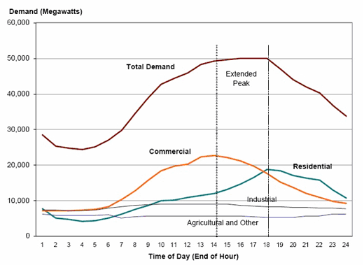
Demand
The demand for electricity has to be met instantly when it arises.
Where does demand come from?
Industry
Tertiary
Residential
Others
Why not simply aim to satisfy the average annual demand?
Consumers’ activities are different during the day/year.
Accordingly, electricity demand varies over time.
Average or total annual demand cannot capture the daily and yearly variations.
Notes:
Electricity is an essential service. When people in households need to turn on the light or doctors in hospitals need to use medical appliances, electricity must be available instantaneously. So, demand must in every moment be met by supply.
Where does demand come from? The total demand in every moment is the sum of the electricity required by every user in every sector (industry, tertiary, residential, transportation, etc.) in that moment.
Looking into the load curves of different sectors during the day we notice the following:
Industrial and agricultural demands are almost constant throughout the day.
Commercial demand is high during the day when all commerial services are open and using differernt appliances for lighting, cooling and other activities. At night, it falls to a minimum level, but not zero, as some demad still exists.
The demand in the residential sector follows people’s activities during the day. It starts increasing when people wake up and start their morining activities, then increases gradually to reach the highest level by 18:00. After that, it starts dropping until the time people are back home. (Hint: this might slightly change from one region to another.)
Aggregating all demands of differerent sectors allows us to notice the extended peak (i.e., spreading over a few hours) of demand for electric power, which comes between the commercial peak the and residential peak time.
Such needs must be always met, so it is important that the system be able to satisfy the demand in every moment, not only the average one. If there are demand peaks, the system must be sized to meet them.

Slide 8
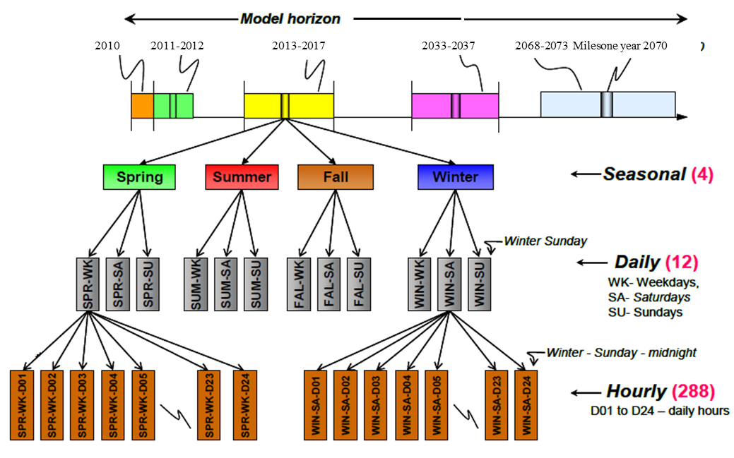
Time slices
All characteristics of the system vary over different time scales (days, weeks, seasons). Think for instance of:
Electricity demand
Rainfall patterns
Irrigation needs and duration of daylight
The year is therefore broken down into representative pieces called time slices.
Both demand and supply (especially intermittent renewables!) are therefore studied at the scale of individual time slices.
Notes:
Since electricity cannot be stored in large quantities and must be supplied when needed, proper capturing or modelling of time is critical to properly plan the electricity supply.
The demand for electricity varies between different seasons. In a cold climate, winter demand is much higher than in summer (the opposite is true in a hot climate). Working days have higher demand (especially in certain hours of the day). On the other hand, some fuel sources have different availability over time (think about solar during nights).

Slide 9
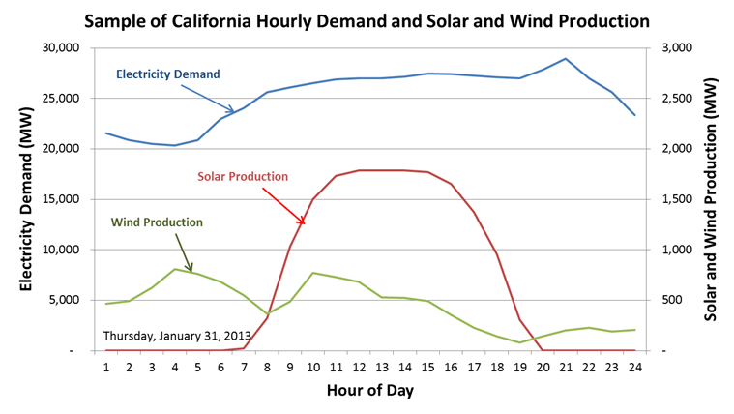
Why are time slices important?
Electricity
(load curve)
Electricity demand (MW)
Availability (percentage)
Water resources
(availability)
0
8760
Notes:
This is a general representation of the variation between electricity load curve and water availability load curve (not from a specific model). Time needs to be considered sensibly to capture this kind of variation between demand and available resources throughout the year. We have less water when we need more electricity, and we have more water available (more rainfall) when we have the lowest demand for electricity. This should lead us to think about storing water or energy to be used in the peak demand season.

Slide 10
Planning the electricity system
Type and schedule of new capacity additions for an uncertain future
Total system capacity requirements
Demand for new capacities
MW
Demand projection
Existing system capacity
Time
Notes:
Why do we need electricity system planning?
A growing population and increasing income per capita (economic development) combine to increase electricity demand.
Demand growth and plant retirements first eliminate any existing reserve capacity, and then lead to a steadily widening capacity gap: The existing demand cannot be met anymore.
This gap needs to be filled through investments in new generating capacity. These require proper analysis, planning and management. We must decide what is the best technology mix to invest in, taking into account all the aforementioned constraints.

Slide 11
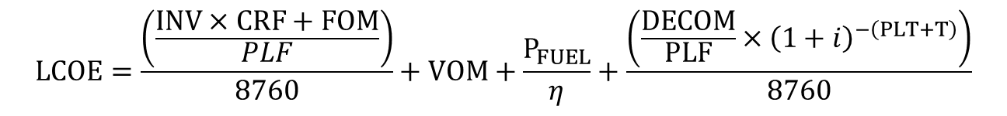
Levelized cost of electricity (LCOE)
Investment and fixed costs
Variable and fuel costs
Decommissioning
$$LCOE=\frac{\left(\frac{INV×CRF+FOM}{PLF}\right)}{8760}+VOM+\frac{P_{FUEL}}{η}+\frac{\left(\frac{DECOM}{PLF}×{\left(1+i\right)}^{−\left(PLT+T\right)}\right)}{8760}$$
LCOE, in $/kWh of electricity output
INV – Overnight investment costs per kW of installed capacity, $/kW_{e}
CRF – Capital recovery factor (annuity)
DECOM – Decommissioning costs per kW of installed capacity, $/kW_{e}
FOM – Fix operating and maintenance costs per year, $/kW_{e}
VOM – Variable operating costs, $/kWh
P_{FUEL} – Fuel price per kWh, in $/kWh input
PLF – Plant factor, i.e., full load hours of plant operation per year, fraction of year
PLT – Plant life time, years
η – Plant thermal efficiency, in percentage
i – Discount rate, in percentage
Notes:
This slide shows what cost items of a technology are included in the common definition of LCOE. Other items can be incorporated in this definition, and therefore in the objective function of energy system models.

Slide 12
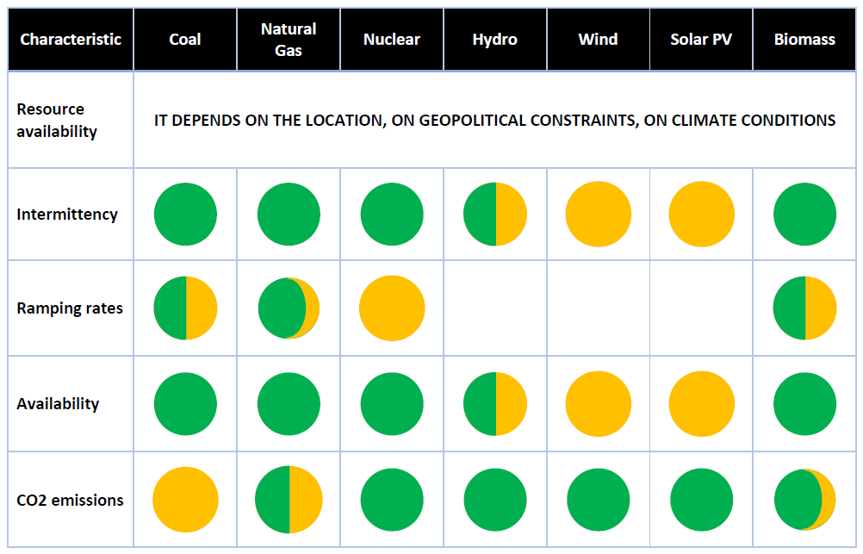
Is LCOE the only decision criterion?
Technologies compete to gain a share in the energy supply, based on their techno-economic characteristics (e.g., levelized cost of electricity), but also given a number of other constraints – resource availability, intermittency of production, ramping rates, etc.
Notes:
Even if the model minimizes the generation costs, the technologies compete based on many other factors not directly related to costs: renewable generation targets imposed by regulations; limits on the use of water, land and other available resources; limits on emissions; acceptability; ramping characteristics; etc.
How do we take into account all these interacting factors, all this complexity?

Slide 13
Basic technology characterization

Slide 14
Exercise 2
Comment in five bullet points on the graphs shown in slide 27 of this presentation.
Answer the following guiding questions:
Which are the main features of each of the technologies plotted?
Why does one need to look at LCOE to compare technologies and decide which one minimizes costs?
Besides what is included in the LCOE calculations, what other criteria need to be taken into account to select technologies for an electricity system?
Notes:
Answer: In this simple example, the peak load will be supplied by T Gas/50 (50 MW open-cycle gas turbines) for around 500 hours; the intermediate load by Carbon/600 (600 MW coal-fuelled steam cycles); and the base load by nuclear/1000 (1000 MW nuclear power plants), which can’t be easily stopped. This is a simple but fair representation of what happens in reality in many cases.

Slide 15
LCOE with realistic load factors
Notes:
The LCOE measure of cost per unit of electricity supplied is lowest for hydro, coal and CCGT, and highest for solar CSP, solar PV and diesel. The cost of solar PV is a case in point. Even though the investment required to install a rooftop PV system is much lower than any other technology, and even the cost of the electricity generation once installed is very small, once all factors are taken into account, the cost of generating electricity is high.

Slide 16
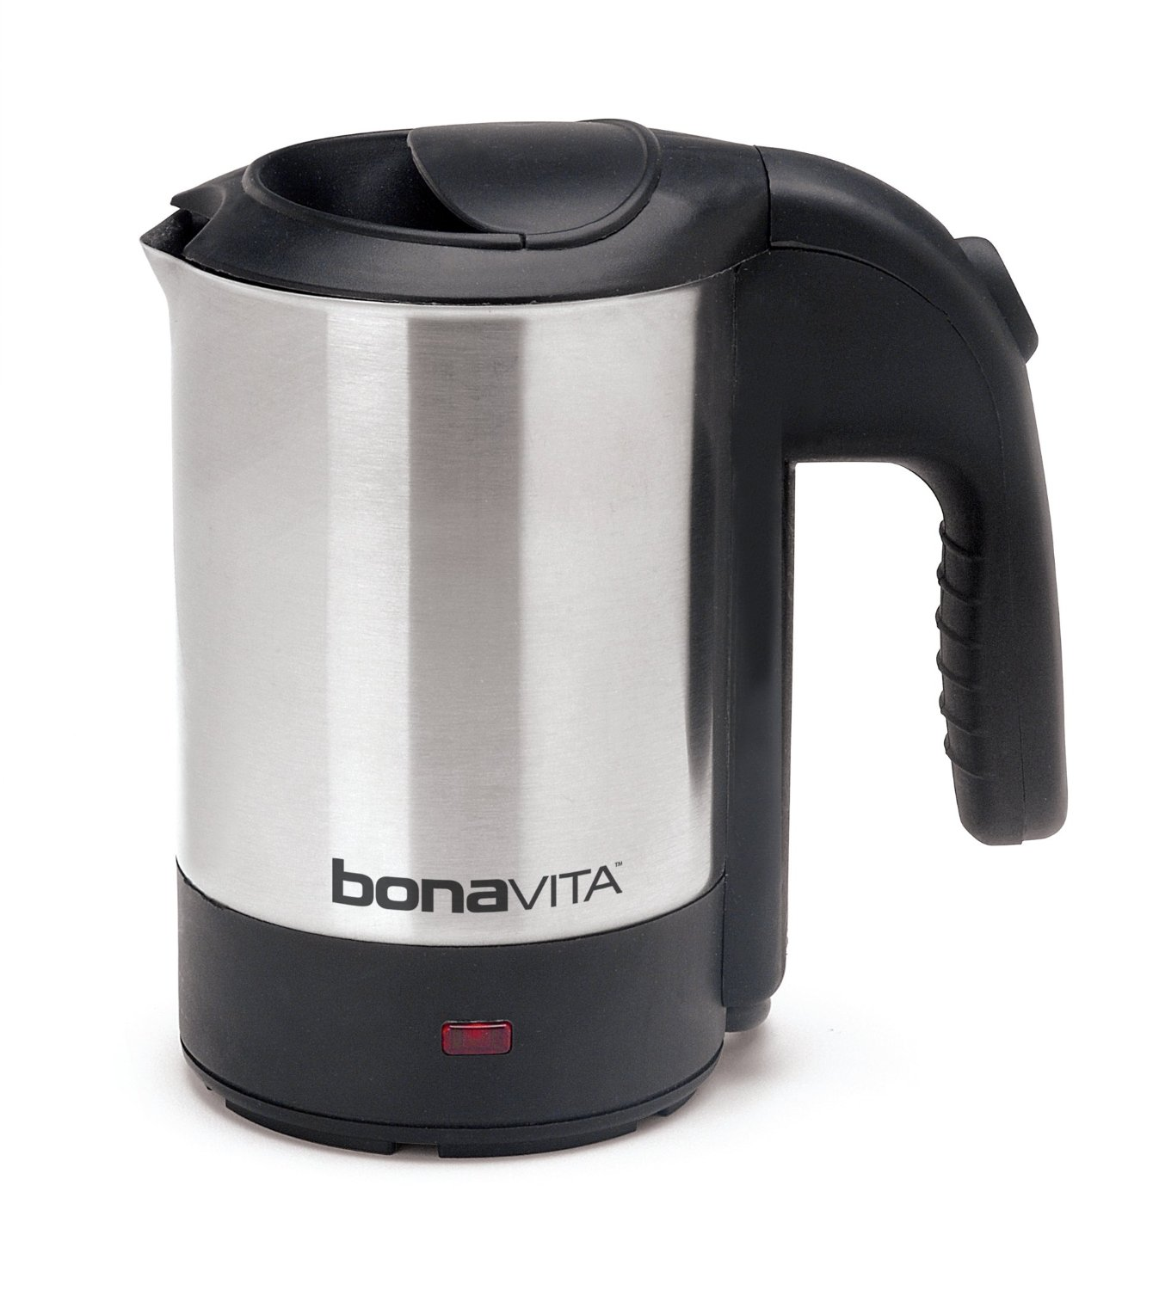

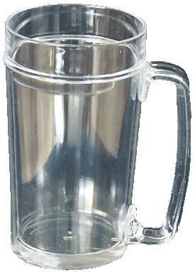
Insights: power vs. energy
Water heater vs. demand for hot water
1 litre in 1 minute
I want: 1 litre in the next minute
Notes:
If needed by the trainees, the simple example in the next three slides explains the difference between power supply (what the power plant can do in every time slice) and energy demand. Energy is projected in the dimension of time. One unit of energy could be demanded in one minute, or diluted in more minutes or hours. This will highly influence how we have to structure our energy supply mix, i.e., how many power plants do we need?
A power plant can be compared to a water heater with the capacity of producing a certain amount of hot water in a certain time. It can’t produce more water in the same time.

Slide 17

Insights: power vs. energy
Water heater vs. demand for hot water
1 litre in 1 minute
I want: 3 litres in the next minute

Slide 18
Insights: power vs. energy
ENERGY DEMAND
POWER SUPPLY
I want: 3 litres in the next minute
1 litre in 1 minute
Notes:
Conclusion: If I want a certain amount of hot water that is more than one water heater can produce, I will need more heaters.

